Slide 1
A
r_{S}=-0.07
p=0.79
N=15
B
C
r_{S}=0.09
p=0.86
N=19
DHE MFI in PBMCs
% of IFNγ⁺ CD8⁺T cells in PBMCs
% of TNF⁺ CD8⁺T cells in PBMCs
r_{S}=0.20
p=0.39
N=19
BMI
BMI
BMI
Suppl. Fig. 1. Production of ROS and proinflammatory cytokines in PBMCs. (A) ROS levels (=DHE MFI), percentages of IFNγ⁺ (B) and TNF⁺ (C) CD8⁺ T cells in PBMCs in relationship with BMI are shown. Spearman coefficient (r_{s}), sample number (N), and p-values are reported in each graph.

Slide 2
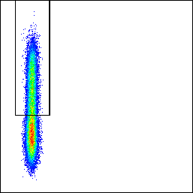
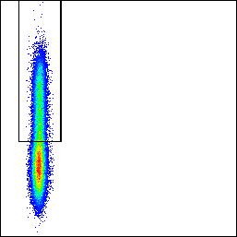
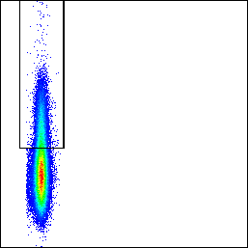
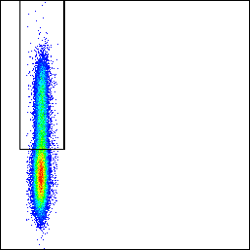
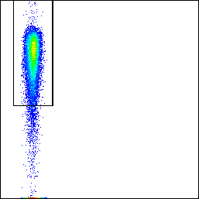
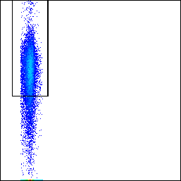
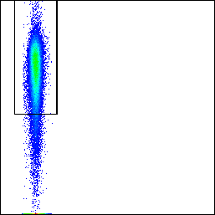
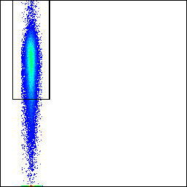
BMI = 24.2
BMI = 37.4
A
BM
IFNγ
PB
B
BM
IFNγ
PB
IFNγ
IFNγ
60.6%
40.2%
28.3%
37.4%
FSC-A
FSC-A
FSC-A
FSC-A
C
BM
TNF
PB
TNF
BM
PB
TNF
D
TNF
79.3%
17.9%
38.9%
35.9%
FSC-A
FSC-A
FSC-A
FSC-A
Suppl. Fig. 2. Representative FACS plots of T cell cytokines in paired BM and PB samples. Representative FACS plots of IFNγ⁺CD8⁺ T cells in a lean donor (BMI=24.2) (A) IFNγ⁺CD8⁺ T cells in an obese donor (BMI= 37.4) (B), TNF⁺CD8⁺ T cells in the same lean donor and (D) TNF⁺CD8⁺ T cells in the same obese donor. CD8⁺ T cells were gated as reported in Figure 2.

Slide 3
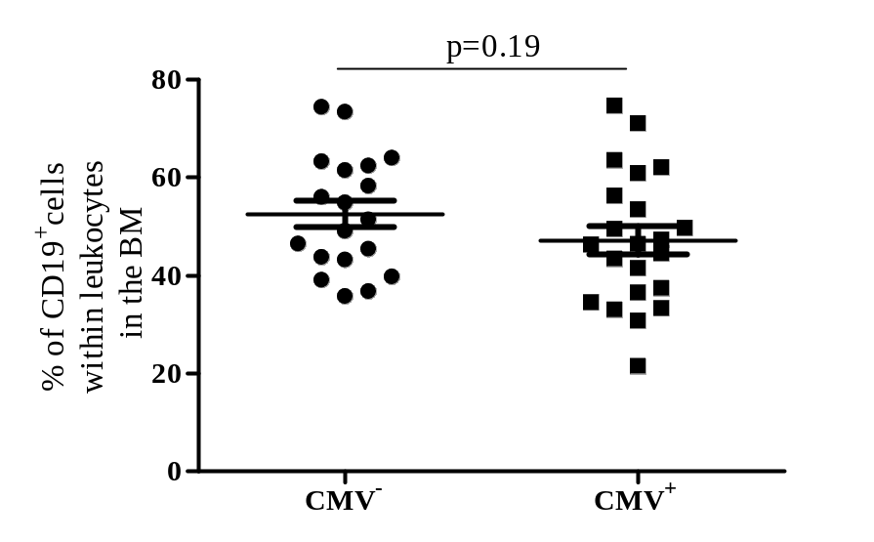
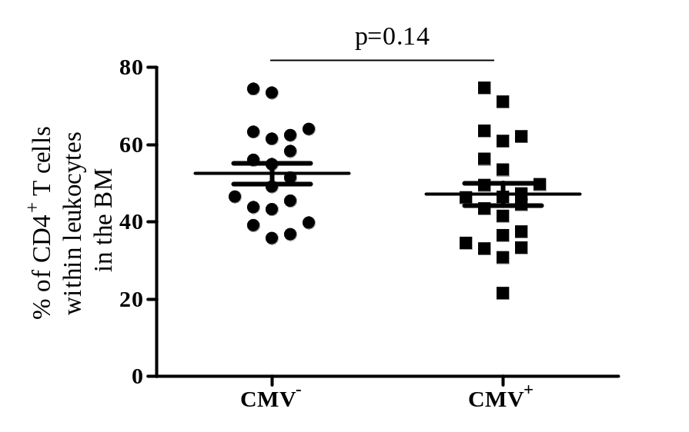
A
B
Suppl. Fig. 3. Frequency of T cells and B cells in the BM of CMV⁻ and CMV⁺ persons. (A) ROS levels (=DHE MFI), percentages of IFNγ⁺ (B) and TNF⁺ (C) CD8⁺ T cells in PBMCs in relationship with BMI are shown. Data are shown as mean ± SEM. Spearman coefficient (r_{s}), sample number (N), and p-values are reported in each graph.

Slide 4
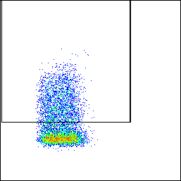
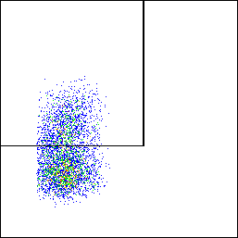
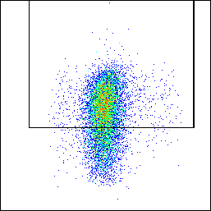
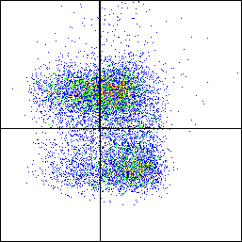
PD-1
IL-7Rα
KLRG-1
IL-7Rα
KLRG-1⁺
MPEC
IL-7Rα⁺
PD-1⁺
SLEC
FSC-A
FSC-A
FSC-A
KLRG-1
Suppl. Fig. 4. Gating strategy for PD-1, IL-7Rα, KLRG-1 and the combination IL-7Rα/KLRG-1 defining IL-7Rα⁺KLRG-1⁻ MPEC and SLEC. PD-1, IL-7Rα and KLRG-1 were gated within either CD8⁺ or CD4⁺ T cells, and MPEC and SLEC within CD8⁺ T cells, as shown in Figure 3.

Slide 5
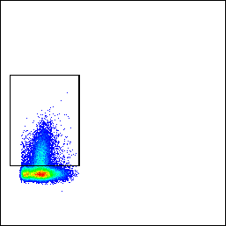
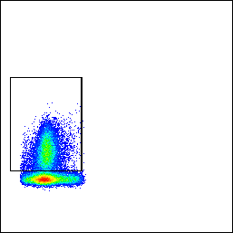
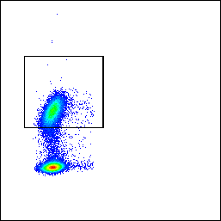
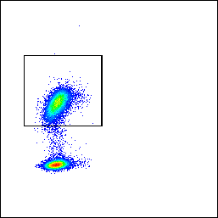
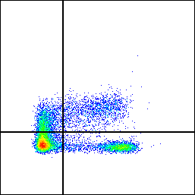
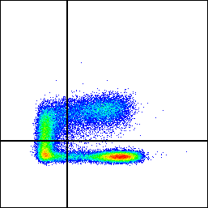
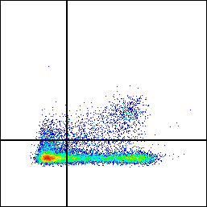
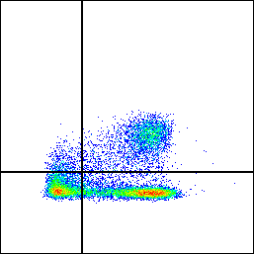
B cells
CD4⁺ T cells (CMV+)
A
B
BMI low
BMI high
CD19
BMI low
CD19
BMI high
CD4
CD4
36.7%
53.3%
19.6%
38.8%
FSC-A
FSC-A
FSC-A
FSC-A
CD4⁺ T cell subsets
CD8⁺ T cell subsets
C
BMI low
BMI high
D
BMI low
BMI high
CCR7
CCR7
CCR7
CCR7
16.3%
11.8%
19.5%
16.1%
3.2%
7.1%
3.3%
22.1%
CM
N
CM
N
CM
N
CM
N
EM
TEMRA
EM
TEMRA
EM
TEMRA
EM
TEMRA
51.3%
20.6%
22.6%
41.8%
47.1%
42.6%
27.4%
47.2%
CD45RA
CD45RA
CD45RA
CD45RA
Suppl. Fig. 5. Representative FACS plots of immune cell subsets in paired BM and PB samples. Representative FACS plots of (A) B cells, (B) CD4⁺ T cells, (C) CD4⁺ T cell subsets and (D) CD8⁺ T cell subsets in donors with low BMI (BMI=22.8) and high BMI (BMI=34.3) are shown. The subsets were gated as reported in Figures 2 and 3.

